Slide 1
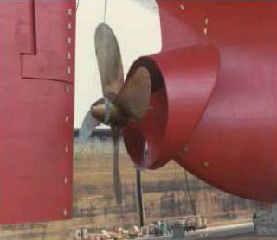


SUSTAINABILITY in SHIPPING
01.Oktober 2013
Dipl. Ing Ramona ZETTELMAIER
Customer Relation & Sales Manager
Marine & Environmental Services
Notes:
Ramona ZETEELMAIER

Slide 2

Source „BAUM e.v

Slide 3


Die Welt steht am Scheideweg
„ Entweder lernt die Menschheit, ihr Wissen und ihre Fähigkeiten den Begrenzungen anzupassen und nachhaltig mit der Erde umzugehen, oder die „Umwelt“ schlägt zurück und lässt das Menschengeschlecht zugrunde gehen“
Ernst Ulrich von Weizsäcker
B.A.U.M.-Umweltpreisträger 2010
Source „BAUM e.v

Slide 4
What is NOT sutsainable !!
If every second around 1000 t ground soil sweeped off
if the foreststand of the earth every second decreases of about 3000 m²
if we eliminate daily 10 bis 50 animal- and plantspecies
If we blow every second around 1000 t greenhouse gas into the air
If a quarter of humanity is responsible for three-quarter of the global CO2- emissions and ca. 80 % of existing Ressources consumed
if 10-20 % Rich 80- 90 % Poor people faced to each other
Source „BAUM e.v

Slide 5

What is Sustainability?
The 3 Dimension of Sustainability
Brundtlandkommission: Nachhaltig ist eine Entwicklung, „die den Bedürfnissen der heutigen Generation entspricht, ohne die Möglichkeiten künftiger Generationen zu gefährden, ihre eigenen Bedürfnisse zu befriedigen und ihren Lebensstil zu wählen.“
Human Being
Environment
Economy
Source: BAUM e.V.

Slide 6
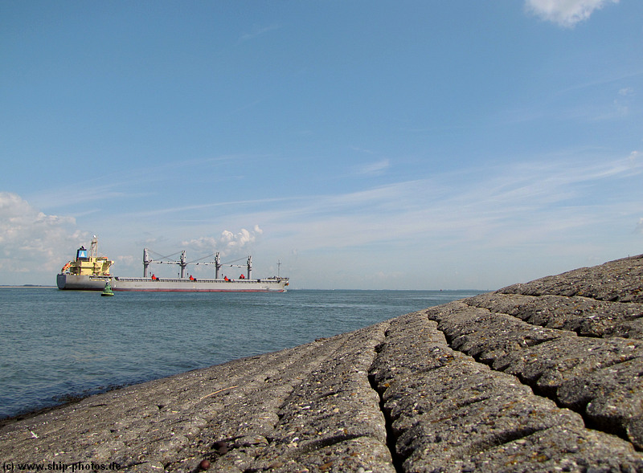
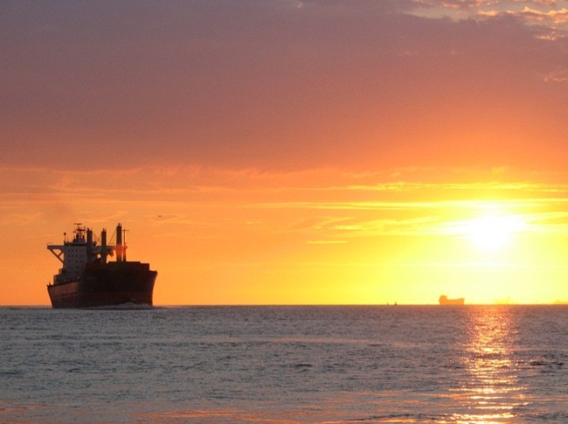
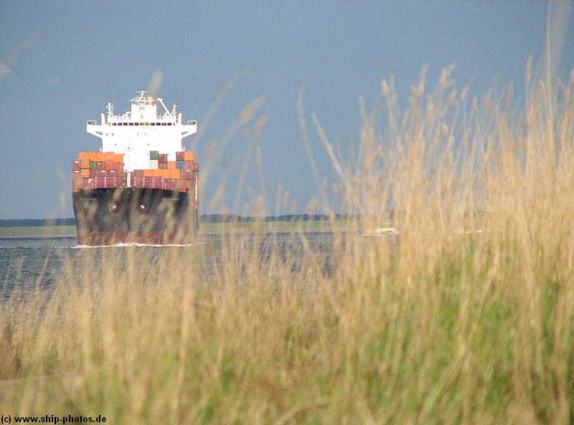

Motive force of economy to sustainable direction

Slide 7
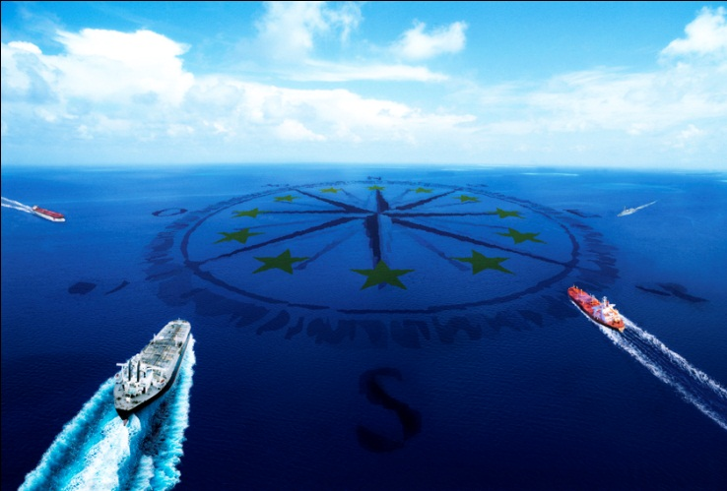
POLITICAL FRAMEWORK-
Regulatory compliance

Slide 8

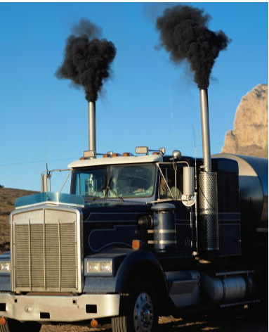
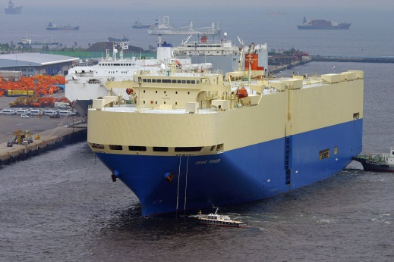
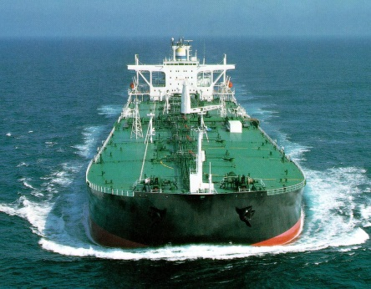
Shipping Emissions
Total shipping emissions | Amount
 | in million tonnes | % of global emissions
CO₂ (International shipping) | 1,046 (870) | 3.3 (2.7)
NOx | 20 | 20 to 30
SOx | 12 | 10
PM | 1.5
Shipping is the most energy efficient mode of transportation
5g CO₂
/ton/km
50g CO₂ /ton/km
15g CO₂
/ton/km
>500g CO₂
/ton/km
Notes:
8
Primary Measures: Improvements inside the engine
Secondary measures: Improvements outside the engine

Slide 9
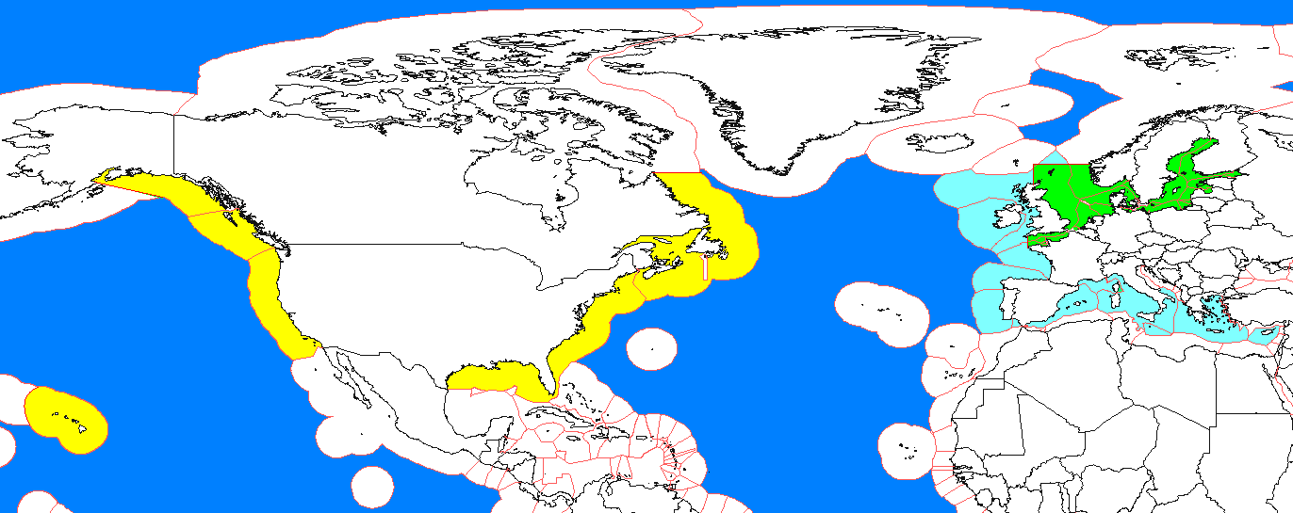
Regulatory context: gradually more stringent rules
IMO and other regulations are becoming more and more stringent:
Progressive reduction of air emissions (SOx, NOx, particulate matters, greenhouse gases including CO2).
Trend to extend the Emission Control Area (ECA for SOx, NOx or particulate matters or all three types of emissions).
Trend of local or regional legislations to reduce SOx emissions at port, e.g. in the US, in the EU.
  Existing ECAs: Baltic Sea (May 2006); North Sea & English Channel (Nov 2007), for SOx
  Newly designated ECAs: US and Canadian coastal waters, for NOx, SOx and PM (adoption MEPC 59, Jul 2009)
  EU ECAs (SOx only)
  Future ECAs may include: Mediterranean Sea, Black Sea, port areas with heavy traffic, etc.

Slide 10
International Regulations for SOx emissions
Regulations | Sulphur Content (in mass)
 | 2010 |  | 2012 | 2015 | 2020 or 2025
IMO – Global (except for passenger ships) | 4.5% |  | 3.5% |  | 0.5%
IMO – ECA – SECA (EU aligned with IMO) | 1.5% | 1.0% (since 01.07.2010) |  | 0.1%
EU ports | 0.1%
California (< 24 nm) | 1.5% (MGO) 0.5% (MDO) |  | 0.1%
Residual fuels
With effect from 18 December, 2012, the EC Sulphur Directive 1999/32/EC is amended by
Directive 2012/33/EU in order to align the EC regulations on sulphur content of marine fuels
with the IMO regulations.
The EC regulations are aligned with the revised Annex VI to MARPOL, both inside and outside EU Sox Emission Control Areas (SECA). The 0.50% limit outside EU SECAs will apply in EC waters from 1 January, 2020, regardless of the outcome of the IMO fuel availability review, which is due by 2018.
Emission abatement methods (e.g. exhaust gas cleaning systems) are permitted for ships of all flags in EC waters as long as they continuously achieve reductions of SOx emissions which are at least equivalent to using compliant marine fuels.
Distillate fuels

Slide 11
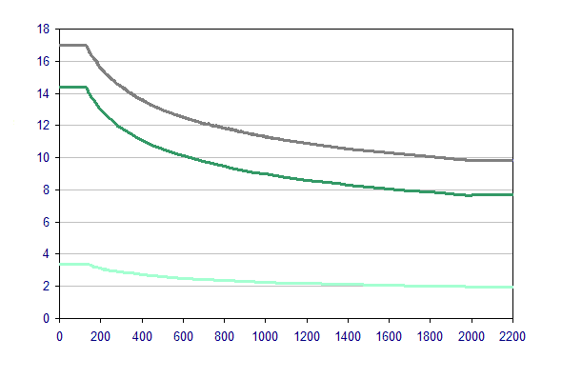
Regulations for NOx emissions
Update (to be confirmed) !
Regulations | NOx emissions
 | 2010 | 2011 | 2021
IMO – outside ECA | Tier I | Tier II
IMO - ECA | Tier I | Tier II | Tier III
NOx emission limits (g/kWh)
Tier III applies only in ECA (not in SECA)
and is not retroactive
For ships fitted with Nox certified engines, specifically
for those using the parameter check method,
replacement of Nox critical components must be
marked up as required. Reocrd book of Engine
parameters must be co:mpleted, even for similar
changes. The approved Technical File must be
on-board for inspection request.
The direct measurement and monitoring method in an
alternative way to demonstrate compliance.
However this still require a technical file.
Ships built before 2000 were initially outside the Nox
certification requirement, except where certain
replacement engines are installed. The introduction
of the « approved method » concept has changed
this for enginesover 5000 kW and of
90 litre/cylinder or more on ships constructed on or
after 1st January 1990 and before 1st January 2000. If an approved method exists it is required to be fitted within a given time period.
Owners of such fleets should remains aware for announcements from IMO.
-20%
Tier I
Tier II
-80%
Tier III
Rated engine speed (rpm)

Slide 12

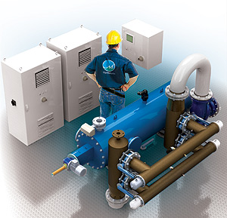
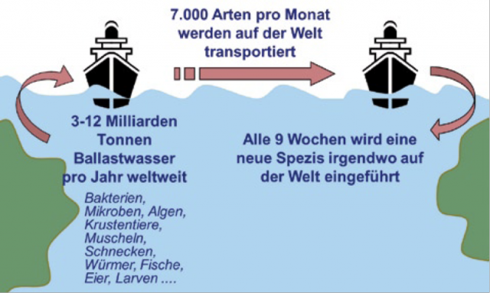

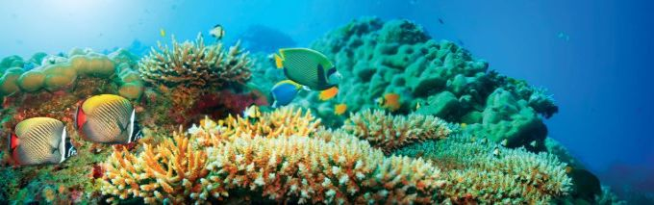
BIODIVERSITY - Ballast Water Management
Ballast Water Management Convention 2004, adopted 13 February 2004, requiring ballast water and sediment management on all voyages
Hull Bio - Fouling

Slide 13

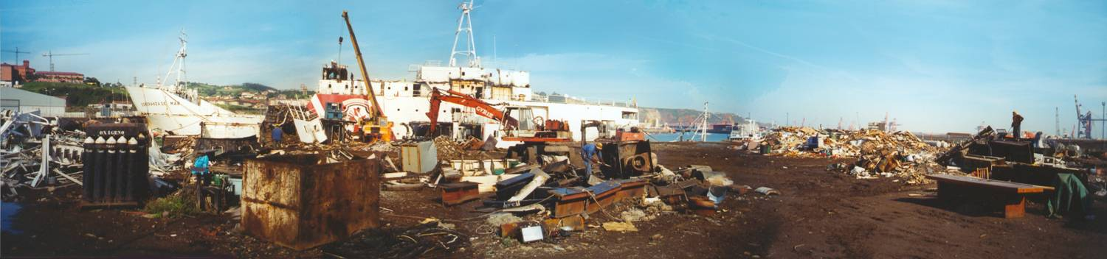
Ship Recycling Convention
Hong Kong International Convention for the Safe & Environmentally Sound Recycling of Ships, adopted in May 2009
- Applies to all ships over 500 GT and flagged by a party subject to the convention
- In force 24 months after ratification by 15 states for 40% world gt and 3% recycling capacity.
- EU considering to require all ship calling EU ports and EU-flagged ships to have an updated inventory for hazardous materials from 2014 for new ships and for existing ships ≥15 years.
Once the Convention is in force ship owners will need :
- An Inventory of Hazardous Materials (IHM) which must be verified and maintained throughout the life of the ship
- Safe and environmentally sound ship recycling plan (to detail process yards must implement)
- A ship recycling plan developed by the authorised recycling facility to fit with the above plan
- Authorisation by the administration of the ship recycling facilities to proceed

Slide 14







MEDIA stronger interest on environmental themes

Slide 15









Buying PUBLIC more strategic & asking for transparency

Slide 16
SHIPPING → Present situation in 2013
Shipping
Crisis
A global overcapacity:
  Global overcapacity of recent ships
  Low rates in the major markets ( bulk carriers, oil tankers, containerships)
  Conclusion from 2012 BRS annual report: “With soaring fuel prices and falling freight rates, it is now critical that shipowners economize and place the emphasis on reducing fuel costs rather than expecting increased earnings.”
Energy
Efficiency
is key
Improvement of energy efficiency is essential to reduce operating costs of existing fleet and to shorten the crisis by accelerating obsolescence of the existing tonnage.
  Reduce fuel costs of existing vessels (slow steaming, trim optimisation, effective implementation of SEEMP)
  Develop new designs with increased efficiency
  measured by EEDI (20% reduction)

Slide 17
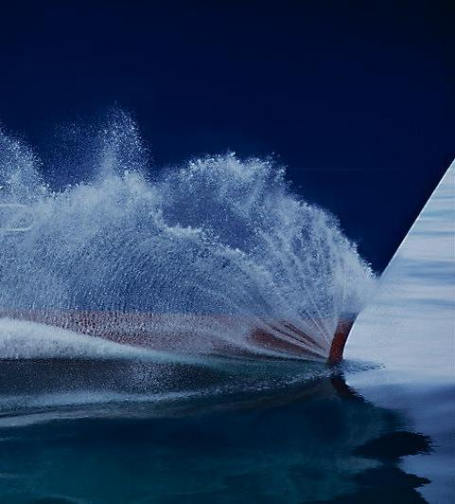
MORE EFFICIENT NEWBUILDINGS

Slide 18

ENERGY-EFFICIENT NEWBUILDINGS
IMO developed a tool to measure (compare) energy efficiency of ship designs: the EEDI
  Not perfect (no consideration of seaworthiness and economy of scale of large ships) but usable
  Progressively applicable to the majority of ship types
Significant improvements of energy efficiency of new designs are possible ( about 20% reduction of fuel consumption)
  Optimisation of hull lines and hull/propeller interactions
  Addition of energy-saving devices (hydrodynamic devices or better energy management)

Slide 19
EEDI and Design innovations
The EEDI of ships is to be calculated according to IMO guidelines:
  Original document : MEPC Circ.1/681
  Calculation guidelines adopted at MEPC 63: Resolution MEPC 213(63)
  Formula:
1.January 2013 Entry into force
Impact of Main Engines
Impact of auxiliary power demand
Impact of PTI reduced by electrical innovations
Reduction of impact due to mechanical innovations
Ship’s work in normal operating condition
Environmental costs CO₂ emissions at 75% MCR + fixed auxiliaries power
Benefits for society cargo capacity x ship speed x correction factors
Notes:
f_{i}, f_{j} for Ice Class Ships
f_{j} for shuttle tankers with propulsion redudancy
f_{i,VSE} for voluntary structural enhancement
f_{i,CSR} for bulk carrier and oil tankers built in acc. with CSR notation
f_{c} cubic capacity corr. factor for chemical tankers / LNG carriers.

Slide 20
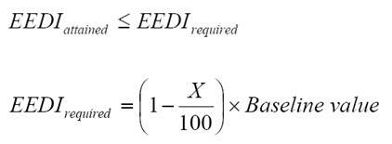
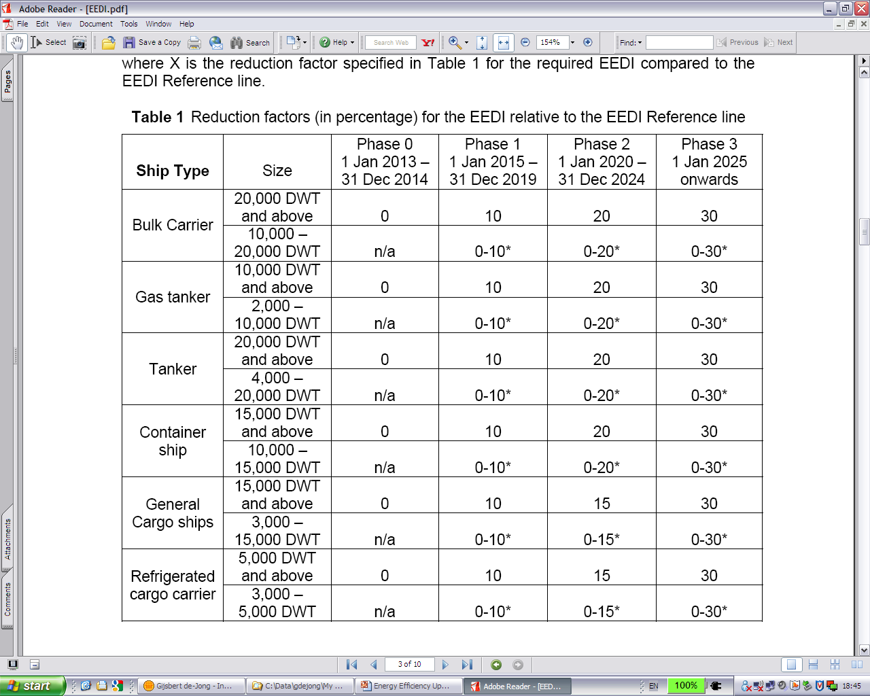
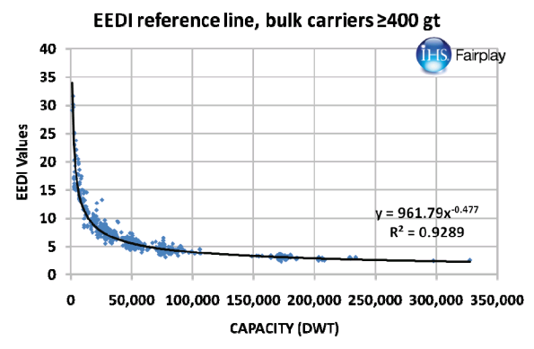
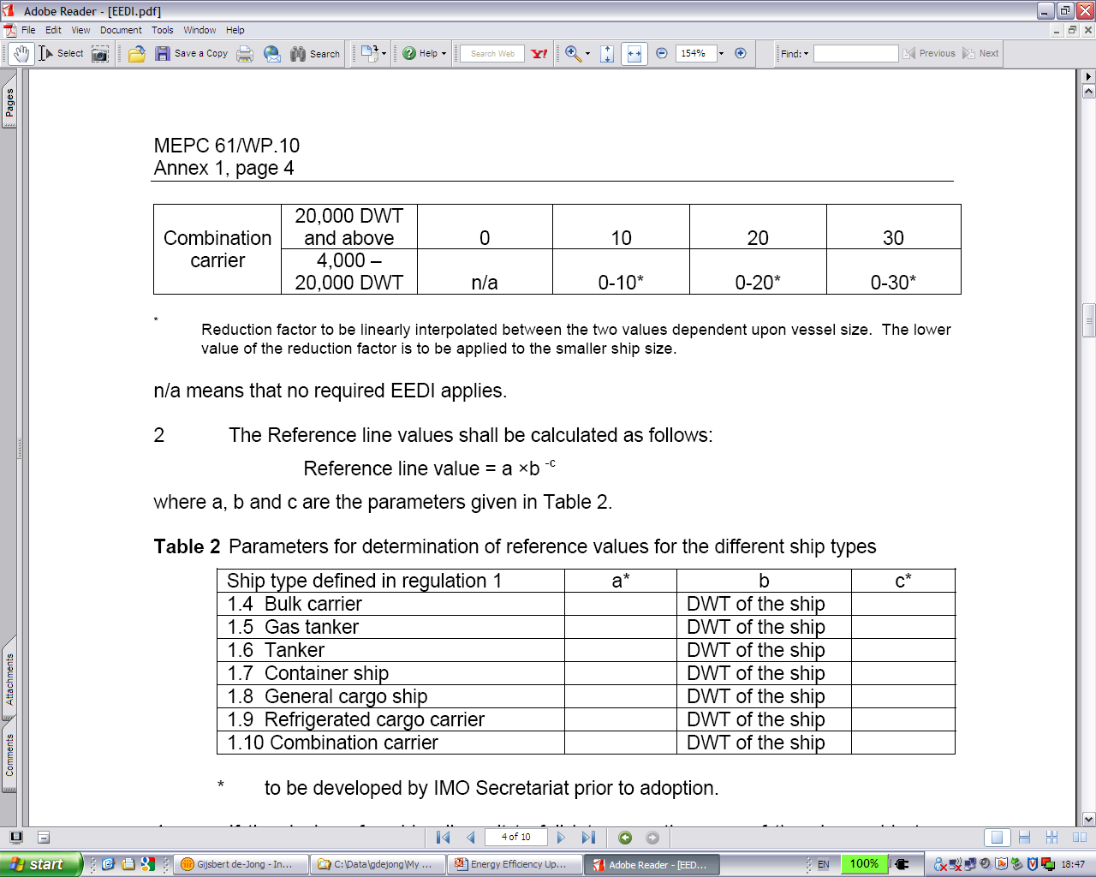
Target Years & Reduction Rates
Draft regulatory text for mandatory EEDI requirements: target years & reduction rates
* Factor to be linearly interpolated between two values dependent upon vessel size (the lower value of reduction factor is to be applied to the smaller ship size).
Notes:
20

Slide 21
Solutions for reducing CO₂ : Energy Efficiency
Reducing CO₂ emissions means lowering fuel oil consumption
for the given ship size (DWT,GRT),
Thus developing more ENERGY EFFICIENT designs of ships
OR using alternative fuels (i.e natural gas)
Fuel oil consumption for new ships can be reduced by:
  Hull form optimization
  Propeller optimization
  The use of energy saving devices
  Waste heat recovery systems
  More efficient engines
  Engine derating – low/medium load optimization
  More efficient turbochargers
  Other measures
LNG as a fuel can reduce CO₂ emissions by 20-25% due to lower carbon content
Fuel Oil
Consumption
Energy
Efficiency
CO₂ Emissions

Slide 22
Reduction of emissions of NO_{x}, SO_{x}, PM and CO₂
Effectiveness of natural gas fuel versus abatement technologies:
Technique / Reduction of | NO_{x} | SO_{x} | PM | CO₂
Combinations of engine modifications | 30-40%
SCR | >90%
Emulsified fuel | 10-20%
Humid Air Motors | 25-50%
Direct Water Injection | ~50%
Exhaust Gas Recycling | 35-60% |  | 20-60%
Filters |  |  | ~95%
Scrubbing |  | 85-100% | 70-100% | up to 85%
1.5% Sulphur fuel |  | ~40% | ~18%
0.5% Sulphur Fuel |  | ~80% | ~20%
Natural Gas Fuel | 80 to 90% | 100% | ~100% | 20 to 25%
IMO Tier 3 standard
is achieved
Reduction
of EEDI
Notes:
Assumptions:
- Rendement HFO 2 temps = 0.49
- Rendement DF 4 temps attaque directe = .47
- Rendement DFDE 4 temps = .43
Therefore:
Cas HFO 2 temps versus DFDE: EEDI (natural gas) = EEDI HFO x 2.75 / 3.1144 / 1.25 x .49 / .43 = EEDI HFO x 0.805
Cas HFO 2 temps versus DF: EEDI (natural gas) = EEDI HFO x 2.75 / 3.1144 / 1.25 x .49 / .47 = EEDI HFO x 0.7365

Slide 23

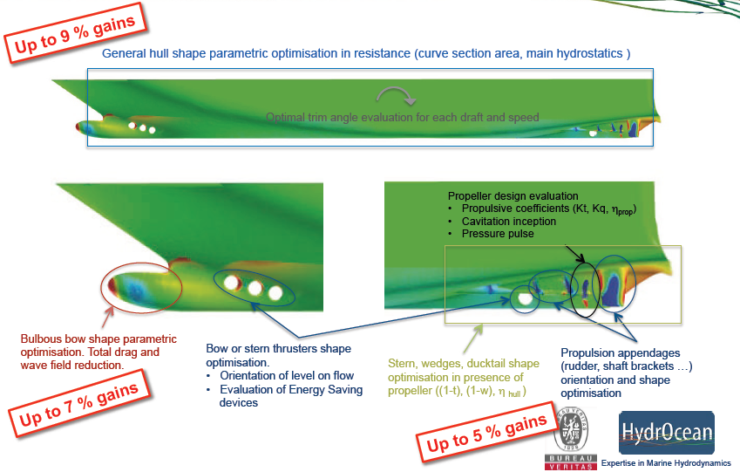
Hull form & appendages optimization

Slide 24
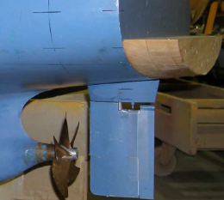
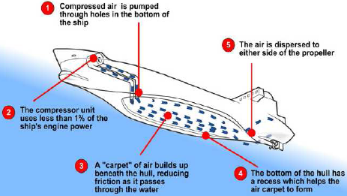
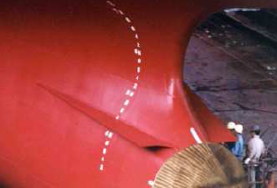
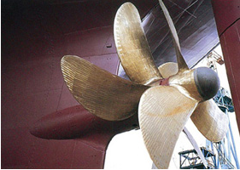

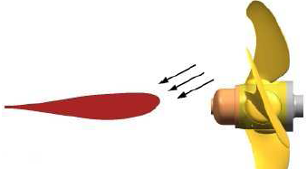
Energy Saving Devices (ESD) - Some options
Ducktail
ACS
Fins in front of prop.
Ship length increased
Reduction in wave resistance 2~5%
Reduction in frictional resistance 7-15% depending on ship type
Reduction in viscous pressure resistance ~2%
CR propeller
Loaded tip propeller
Twisted rudder
Recovering of kinetic energy due to the rotational flow
SSPA 5~10%
Improved efficiency 6~12%
Reduction in viscous pressure resistance ~2%

Slide 25
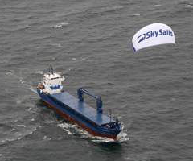
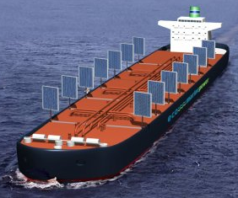
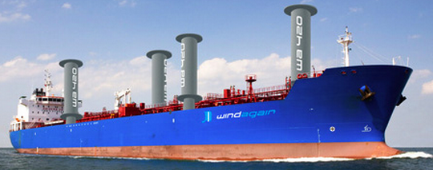
Other Green Measures
Harvesting the solar and wind energy
Kite Sails
Solar Sails
Flettner Rotors
Notes:
A rotor ship, or Flettner ship, is a ship designed to use the Magnus effect for propulsion. To take advantage of this effect, it uses rotorsails which are powered by an engine. The Magnus effect is a force acting on a spinning body in a moving airstream, which acts perpendicularly to the direction of the airstream. German engineer Anton Flettner was the first to build a ship which attempted to tap this force for propulsion.

Slide 26
  Ship Energy Efficiency Management Plan (SEEMP)
Reference | MSC.203(62) – New chapter 4 to MARPOL Annex VI – Reg.22
Entry into force | 01/01/2013 (new ships) – by the first IAPP intermediate or renewal survey, whichever is first, on or after 01/01/2013 for existing ships
Applicable to | all new & existing ships ≥ 400gt
The SEEMP is a ship environmental performance management tool :
It should be developed by the owner in accordance with the IMO Guidelines adopted at MEPC 63 in March 2012 (actually as of MEPC.1/ Circ.683).
There are four steps to consider:
Planning
Implementation
which determines the status of ship energy usage and the expected improvements of ship energy efficiency
which includes the development of the procedures for energy management and the definition of the tasks to be performed
Self Evaluation & Improvement
Monitoring & Measurement
to evaluate the effectiveness of the planned measures and of their implementation and to improve the SEEMP
which provides a quantitative indicator of the ship energy effiency

Slide 27
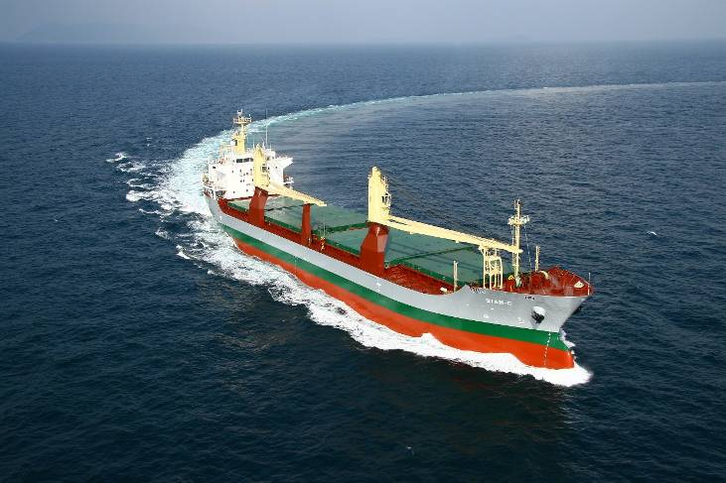
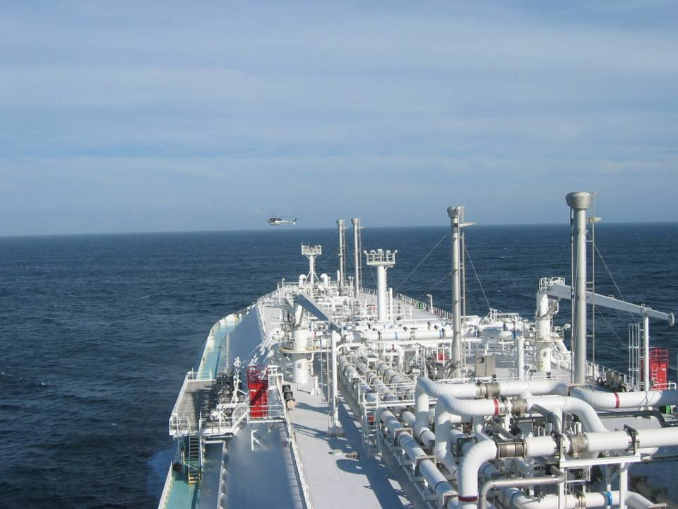
Possible measures for Cargo ship
IMO recommends a list of best practices for Fuel-Efficient Operations of Ships
Fuel-Efficient Operations
  Weather routeing
  Just in time (Port communication, speed selection)
  Speed optimization (slow steaming)
  Optimized shaft power
Optimized ship handling
  Optimum trim/ballast
  Optimum ballast
  Optimum propeller and propeller inflow considerations
  Optimum use of rudder and heading control systems (autopilots)
Hull maintenance
Propulsion system maintenance
Waste heat recovery
Improved fleet management
Energy management
Fuel Type…

Slide 28
Energy Efficiency Operation Index (EEOI)
Reference | MEPC 59 – MEPC.1/Circ.684
The EEOI objective is to facilitate the quantitative monitoring of energy efficiency and thus it may be used for the monitoring of SEEMP
The formula is:
Capacity:
DWT: Dry cargo ships, Tankers, Gas Tankers
Passengers: Passenger ships
TEU: Container ships
Simple, straight forward calculation
The EEOI can be calculated for one trip or for a certain period covering several trips (ballast ones included)
Notes:
For LNG carriers, there is proposal for the shaft power of the steam turbine to be used for PME (steam turbine)

Slide 29
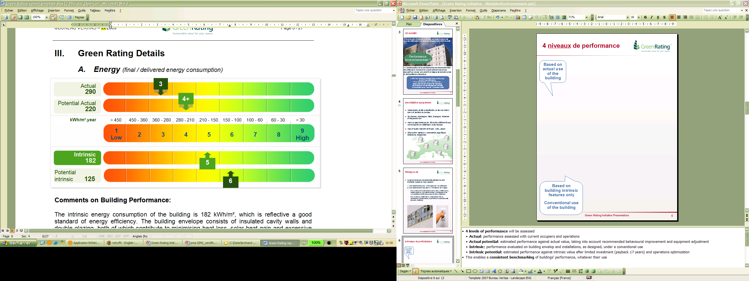
Green Rating for Each Individual Index
The calculated fuel consumption, NOx, SOx, & CO₂ emissions are rated using BV Green Rating. Goal based optimization can be achieved with Green Rating
Green rating is continued during the operation of the ship by monitoring its energy and emissions’ performance
Intrinsic level: based on standard operational profile (pre-determined) Enables comparison between designs
Actual level: based on direct measured on-board (real time) Supports implementation of Ship Energy Efficiency Management Plan
Compare with potential performance (design, target) at both levels
Green Rating
Energy performance

Slide 30
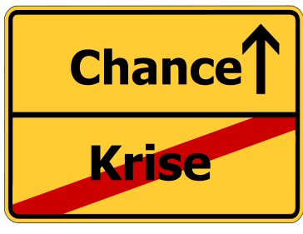
CO- Emission → a deal-breaker for the sub-contractor ?
Carbon Disclosure Project (CDP) : internaltional corporate groups are asked for the handling of CO2-Emission and and will judge on this basis
According on market opinions of Concerns (ie Google, Loreal, Vodafone etc) majority would not signed a contract with companies, who could not measure and improve their climate eco-balance
Organizations regognises more often the raising greater chances of a sustainable business managment !
Investments on business economics are accountable on
short, medium and longterm basis
Reduce Risk
Reduce costs
Gain Employee

Slide 31

Sustainability issues
Typically facing the Shipping Companies -
Social
Employees
- diversity
- job creation
- human factors
- training & development
- Cultural audits
- Safety (fatalities)
Business ethics
- standards / codes of practice
- bribery and corruption
- political activity
Human rights especially in supply chain and exploration (ILO)
Growing and aging populations
Poverty
Environment
Regulatory compliance
Emissions reduction
Waste minimisation
Climate change
- carbon reduction
- energy efficiency and products
- ISO 14064, GHG
Green procurement (i.e. Green Passport)
Spill prevention/pollution
Biodiversity (BWM)
Working in environmentally sensitive areas
Ecocnomic
Revenue management
- world debt
- credit crisis
Earnings
Costs - resource efficiency
Business continuity
- access to new oil reserves /
energy
- new fuel technology
- Information Security Management
Stricter competition with international companies / taxes, etc
SUSTAINABILITY
Notes:
Folgende Thematiken sind typisch für eine Reederei oder einen Schiffsmanager.
Umweltschutz
Übereinstimmung mit den gesetzlichen Vorgaben
Reduzierung des Schadstoffausstosses
Mimimierung des erzeugten Abfalls einschliesslich Ladungsreste
Klimawandel: Reduzierung des CO2 Ausstosses, Energy Effizienz, ISO 14064-Treibhausgasreduzierung
Umweltfreundlicher Einkauf und Einsatz von entsprechenden Materialen (Green Passport)
Vermeidung von Verschmutzung
Erhaltung der Artenvielfalt (Ballast Wasser Management)
Arbeiten in umweltkritischen Bereichen und Regionen
Sozialer Fortschritt

Slide 32
CASE STUDIES 1-3
Examples

Slide 33


Guillaume Hagi – Brittany Ferries
Optimising Energy Efficiency in Operation
Notes:
Thank you Mr Chairman,
This presentation is based on Brittany Ferries experience with the use of SEEMP to help us in energy management and fuel savings.
As we had some hard times and long discussions with Martial from Bureau Veritas on what to do and how to do it, we finally decided to have a common presentation showing both the Owner’s point of view and the way the Class society managed to help us in formalizing and simulating experimental results.

Slide 34
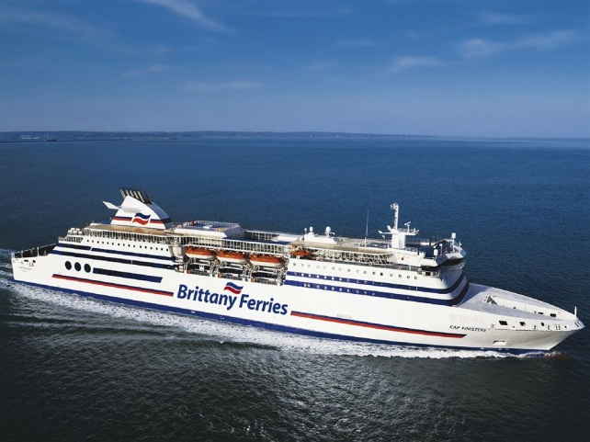
Optimisation measures adopted onboard Cap Finistère
Optimisation de l’assiette
Peinture silicone
Variateurs sur les pompes
Notes:
From 2007 we had experiments with silicone paint.
The graph displays Consumption in grams/nautical mile and, you can see three curves :
The yellow curve is the consumption of a vessel before dry-docking
The blue curve shows the consumption of the same vessel after dry-docking, including complete main engine overhaul and sand blasting + complete new paint system
The red curve shows the consumption after applying silicon paint (without blasting) and without main engine overhaul (it was not required)
There is no scale on the graph, but you have already understood that we consider it as a great result.

Slide 35
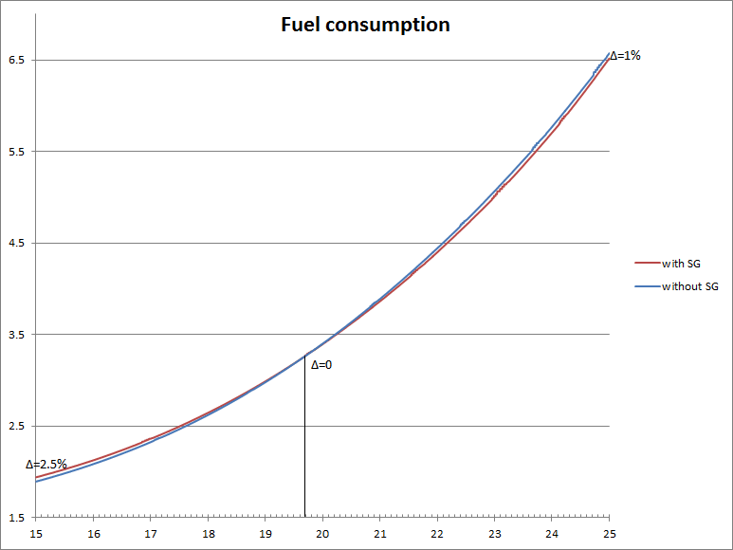
SEECAT - Cap Finistère – fuel saving example
SEECAT– Application on Cap Finistère – In service optimisation
Configuration with clutched shaft alternators or unclutched (diesel generators started)
The power gain is calculated from the original fuel consumption, global approach according to the operational profile of the ship;
Potential saving of 180000 $/year
Optimum connections of the shaft alternators depending on rotation speed of the shaft lines and needed electrical power and efficiciency of the diesel generators
The best operationnal and lower consumption are highlighted by SEECAT.

Slide 36
CASE STUDY 2

Slide 37

Cooling of the main engine onboard a 8000 TEU
SEA WATER COOLING CIRCUIT
FRESH WATER COOLING CIRCUIT
ENGINE
TT

Slide 38
Optimisation of the cooling system
with frequency variators
Potential electrical power saving of -70 % !
SEA WATER COOLING CIRCUIT
FRESH WATER COOLING CIRCUIT
ENGINE
TT

Slide 39
CASE STUDY 3

Slide 40
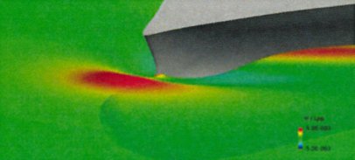
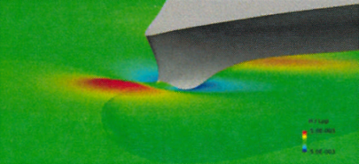
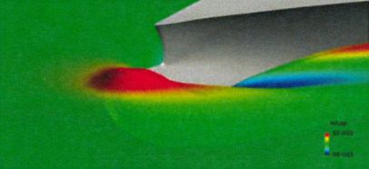
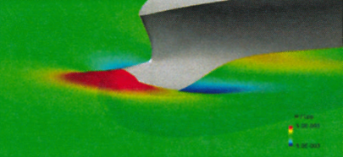
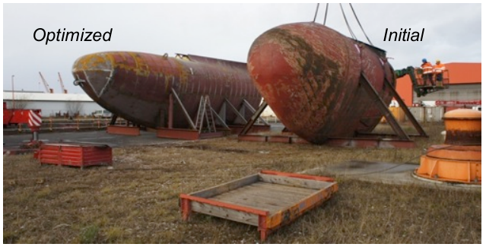
Slow steaming and change of bulbous bow
Pre requested conditions:
  The original bulbous bow must have been optimised for high speed and loaded draft
  The slow steaming operations must be drastically different from previous ones (draft and speed)
In that conditions significant gains are obtained (-10%) on a large range of the operational speeds.
A large number of numerical calculations can be done for different parameters variations (hundreds)
Gain total de consommation
F
orme initiale
10%
9%
14m
8%
18nds
13m
Potential total power saving of -10 % !
15nds
7%
6%
18nds
12m
15nds
5%
4%
21nds
3%
18nds
2%
9.5m
1%
15nds
0%

Slide 41

Let’s drive innovation
with confidence !
Notes:
41

Slide 42

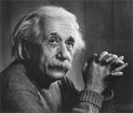

„Liebe Nachwelt!
Wenn Ihr nicht gerechter, friedlicher und überhaupt
vernünftiger sein werdet, als wir es sind bzw. gewesen sind, so
soll Euch der Teufel holen!“
Diesen frommen Wunsch mit aller Hochachtung geäußert
habend, bin ich Euer (ehemaliger)
Albert Einstein.“
Source: BAUM e.V.

Slide 43
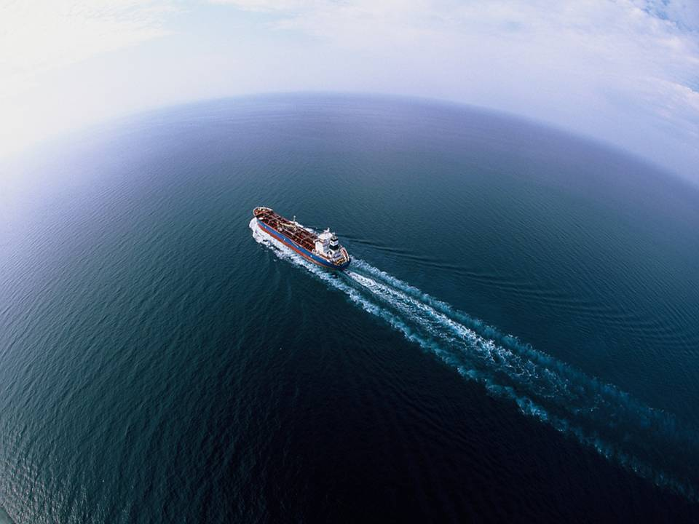

Thank you
Dipl Ing. Ramona Zettelmaier
Email: ramona.zettelmaier@de.bureauveritas.com
Notes:
43

