Slide 1

01.10.2013
Sustainable Shipping
The Engine Perspective
Dr. Hinrich Mohr
AVL List GmbH

Slide 2

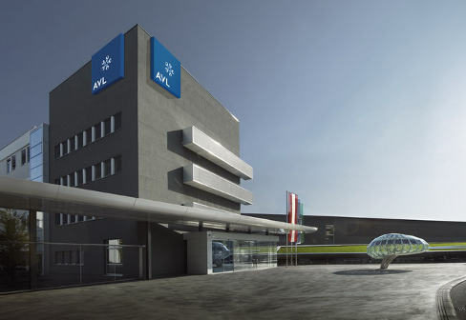
Who is AVL from Graz/Austria?
  World's largest privately owned and independent company
  for
  engineering of powertrain systems (combustion engines, hybrid systems, electric drives)
  software for engine and vehicle simulation
  instrumentation and test systems
  Involved in more than 1,500 engine development projects
  More than 4,000 test bed installations executed
  Founded 1948
  > 6,200 employees worldwide
  45 representations & affiliates worldwide
  > 1,000 Mio. € turnover in 2012
Notes:
2

Slide 3
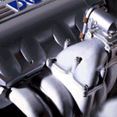
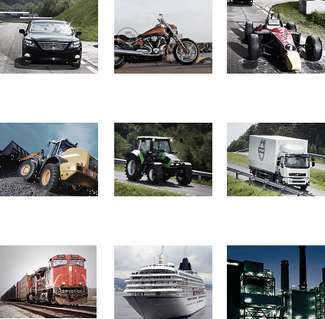
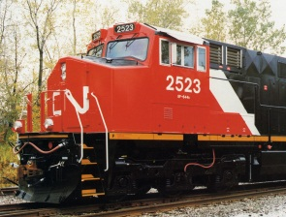
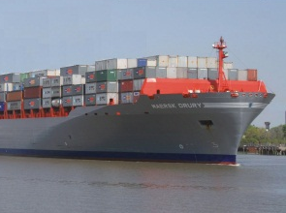







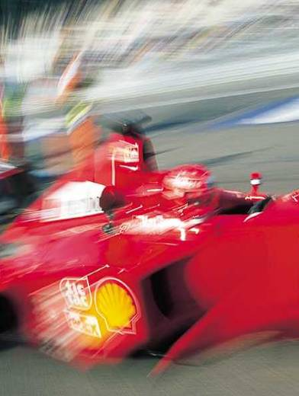
AVL covers all Engine Segments
Engineering
Marine
Power Plants
Locomotive
Simulation
Construction
Agriculture
Commercial Vehicle
Testing
Passenger Cars
2-Wheelers
Racing
We are marrying Industry Needs with Innovation.

Slide 4
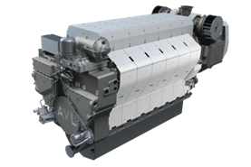
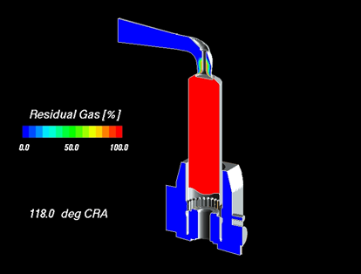
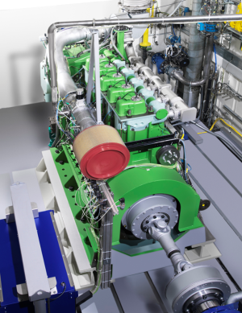
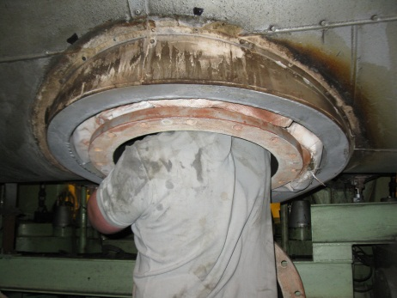
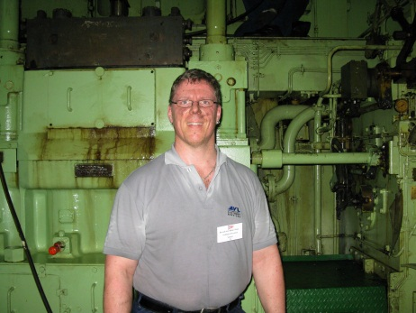
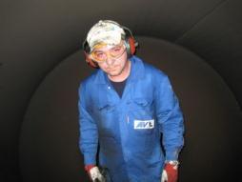
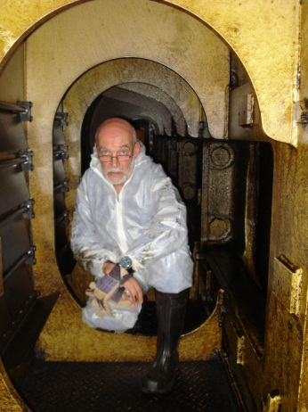
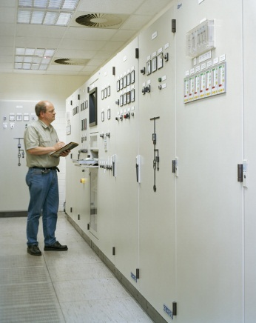
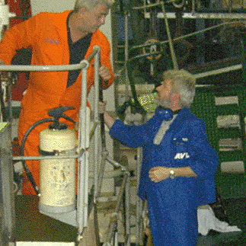
AVL is well-known for …
Engineering
Simulation
Testing
… but we are also out in the field supporting the operators!
Notes:
4

Slide 5

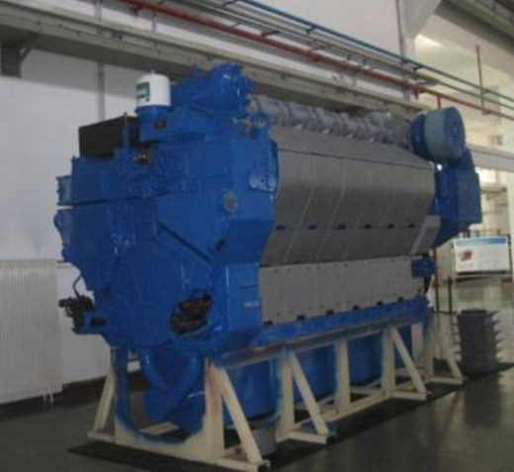
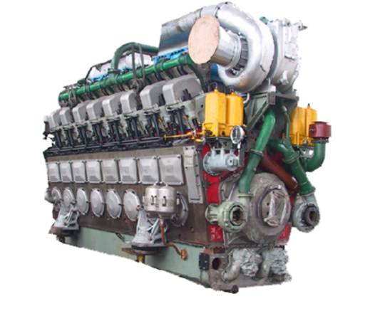
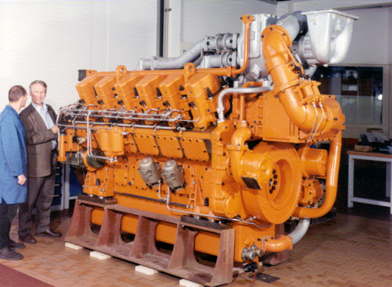
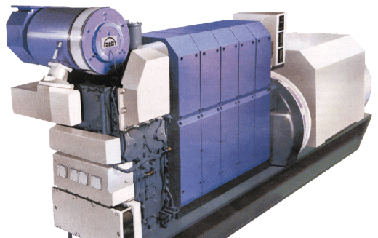
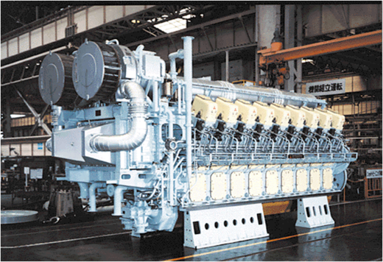
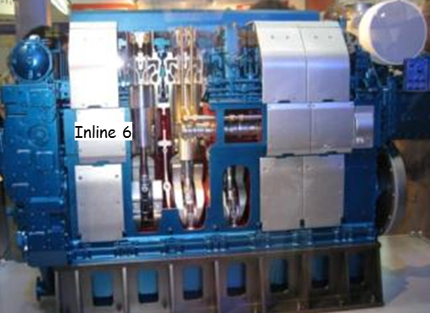
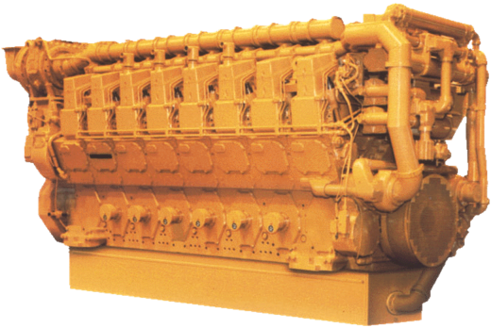
AVL Large Engine References
(Examples out of more than 130 Projects)

Slide 6
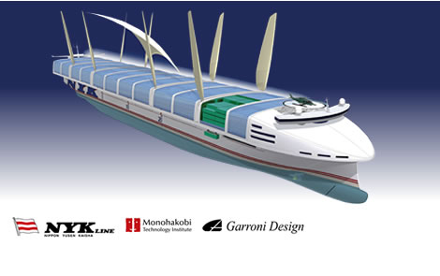
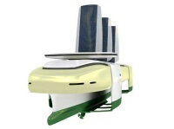
Sustainable Shipping
Drivers
What are the drivers for 'Sustainable Shipping'?
increased sensitivity for environment protection on political and public levels
upcoming international and local requirements for emission reduction (e. g. IMO Tier 3, US EPA Tier 4 Marine, EU Harbour Directive, …)
current low level of charter rates
increased price level of classical standard marine fuels (HFO, MDO)
customers striving for 'green image'
NYK
Wilhelmsen

Slide 7
Sustainable Shipping
Topics
What means 'Sustainable Shipping' from the engine perspective?
Slow steaming ???
Engine derating ???
This is too simple - the topics are:
Improved engine efficiency
Waste heat recovery for power generation
Clean fuels
Reduced engine emissions (internal & by exhaust aftertreatment)
Power generation system integration & flexible power distribution
Condition monitoring for ensurance of optimum engine operation
Hybrid systems, sails, … (at least for niche applications)
See following examples …

Slide 8
Example
IMO Tier 3 Fulfilment Options
Cooler requirement
Valve train
Turbocharging
Architecture
EGR rate
Cooled / uncooled
SSTC / TSTC
ECA / Non ECA
Power Density
Part load operation
Transient operation
Multiple injection
HFO capability
Injection pressure
Cylinder head modification
IMO 3
Type of EAS
Injection potential
HFO capability
Sulphur Content
Gas pressure
Packaging
Valve dimension
Transient operation
ECA / NonECA & DF
Part load operation
Packaging
Conversion rate
ECA / Non ECA
Valves
Diesel / Gas
Combustion layout
Exhaust temp.
SSTC / TSTC
Urea Dosing

Slide 9
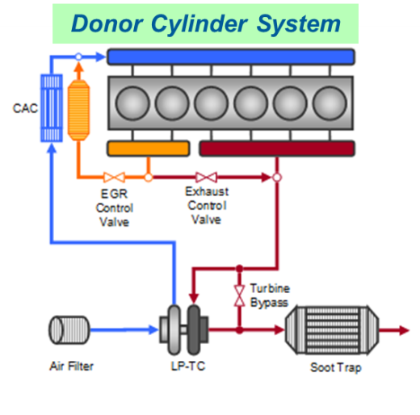
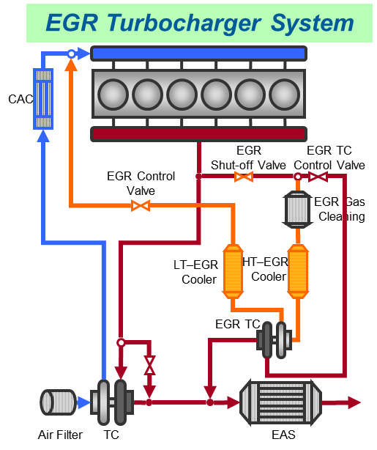
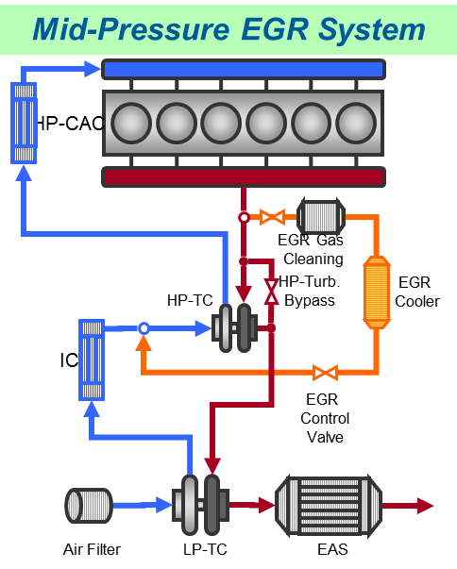
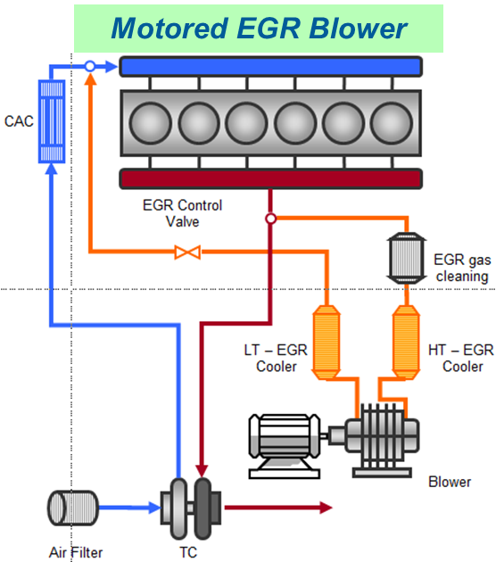
Example
IMO Tier 3 Fulfilment – EGR Variants

Slide 10
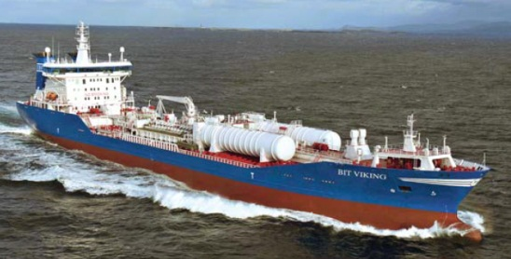
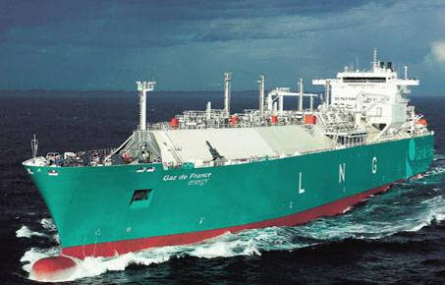
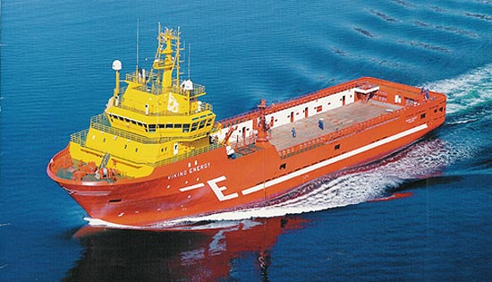
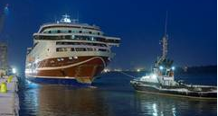
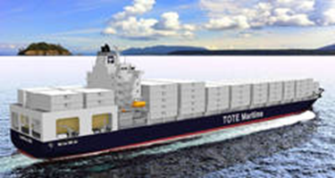
Example
Dual-Fuel Engine Usage
Already Existing:
LNG Carriers
OSVs
Cruise Ferry
Product Tanker
Ordered:
Container Vessels
Cruise Liners
Germanischer Lloyd / Wärtsilä
www.marinelog.com
Expected Future:
River Boats and Coasters
Auxiliary Engines on large Cargo Vessels
Main Propulsion Engines on large Cargo Vessels
www.ship-technology.com
Ship & Offshore
Ship & Offshore

Slide 11
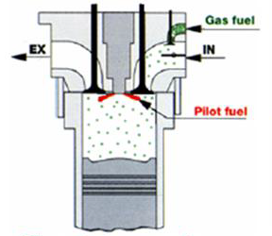
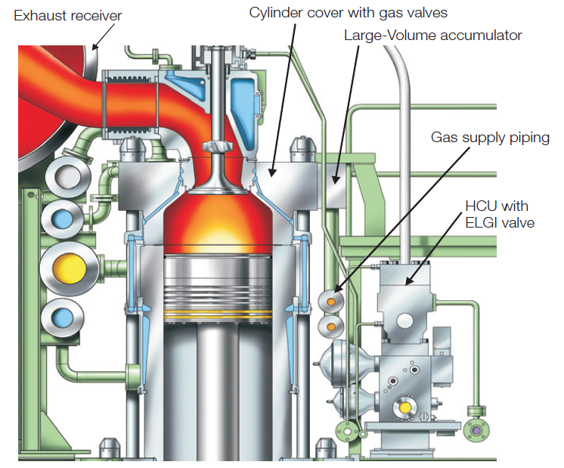
Example
Dual-Fuel Engines – Applied Technologies
Dual-Fuel
Medium-Speed 4-Stroke
HFO-/Gas-Operation
Low-Pressure Gas Supply
Premixed Combustion
Dual-Fuel
Slow-Speed 2-Stroke
HFO-/Gas-Operation
High-Pressure Gas Supply
Diffusion Combustion
Wärtsilä
MAN Diesel & Turbo

Slide 12
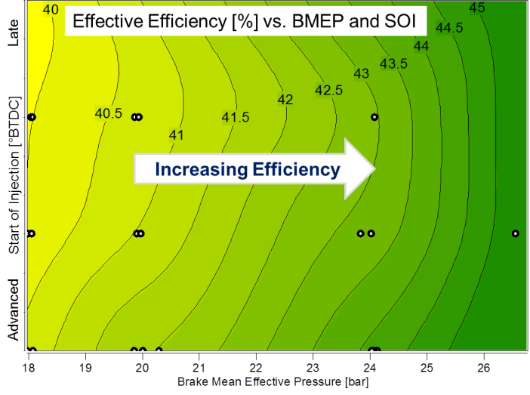
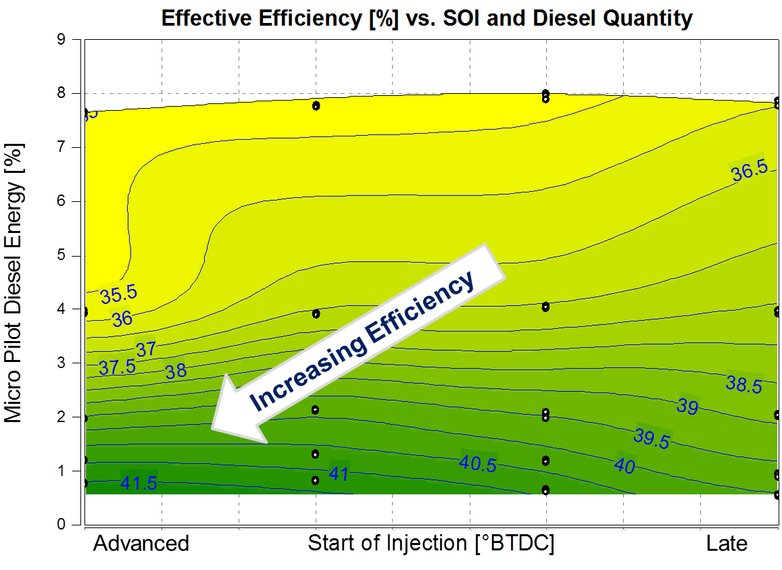
Example
Dual-Fuel Engines – R&D Activities
Performed on AVL's medium-speed SCE
Achieved Performance Values:
27 bar BMEP
45 % effective efficiency
< 3 % COV-IMEP
(@ 2 g/kWh NO_{x})
optimum efficiency values @ approx. 1 % pilot fuel amount
higher pilot fuel amounts cause higher NO_{x} emissions
A/F-ratio  to keep NO_{x} stable
retarded combustion, HC , η 

Slide 13
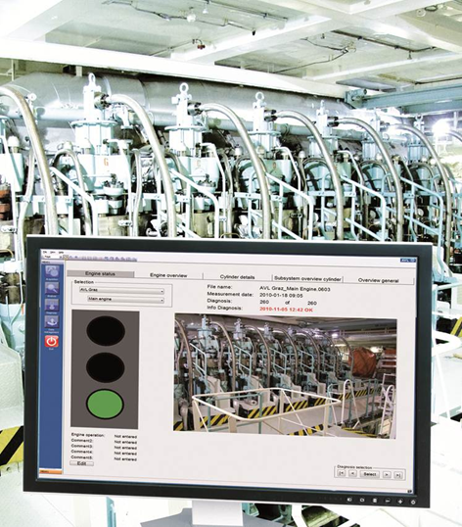
Example
Condition Monitoring (AVL EPOSTM)
Benefits:
early detection of upcoming faults and avoidance of damages
regular engine operation optimization possible
unplanned repair works can be changed to planned maintenance works
experience show optimization potential up to 3 % efficiency (≈ 4 … 6 g/kWh) on usual maintained engines, even higher on poor maintened engines ⇨ respective CO₂ reduction potential
consequent use of delivered information about engine status enables savings of up to 100.000 US-$ per year

Slide 14
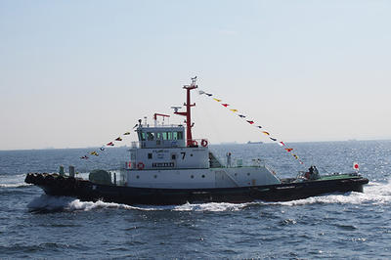
Example
Hybrid Harbour Tug
Niigata Power Systems
Niigata Power Systems
NYK
Niigata Power Systems

Slide 15
01.10.2013
Sustainable Shipping
The Engine Perspective
The engine future will be sustainable …
… for the products
and for us engineers ☺

